Slide 1
Safety training
Department of Art, Graphic Design and Art History
Epilog laser cutter

Slide 2
The Art Department laser cutters are designed to be safe when used properly. This power point covers basic safety features that are in place so that you can identify when things are not working correctly, or may need to be checked.

Slide 3
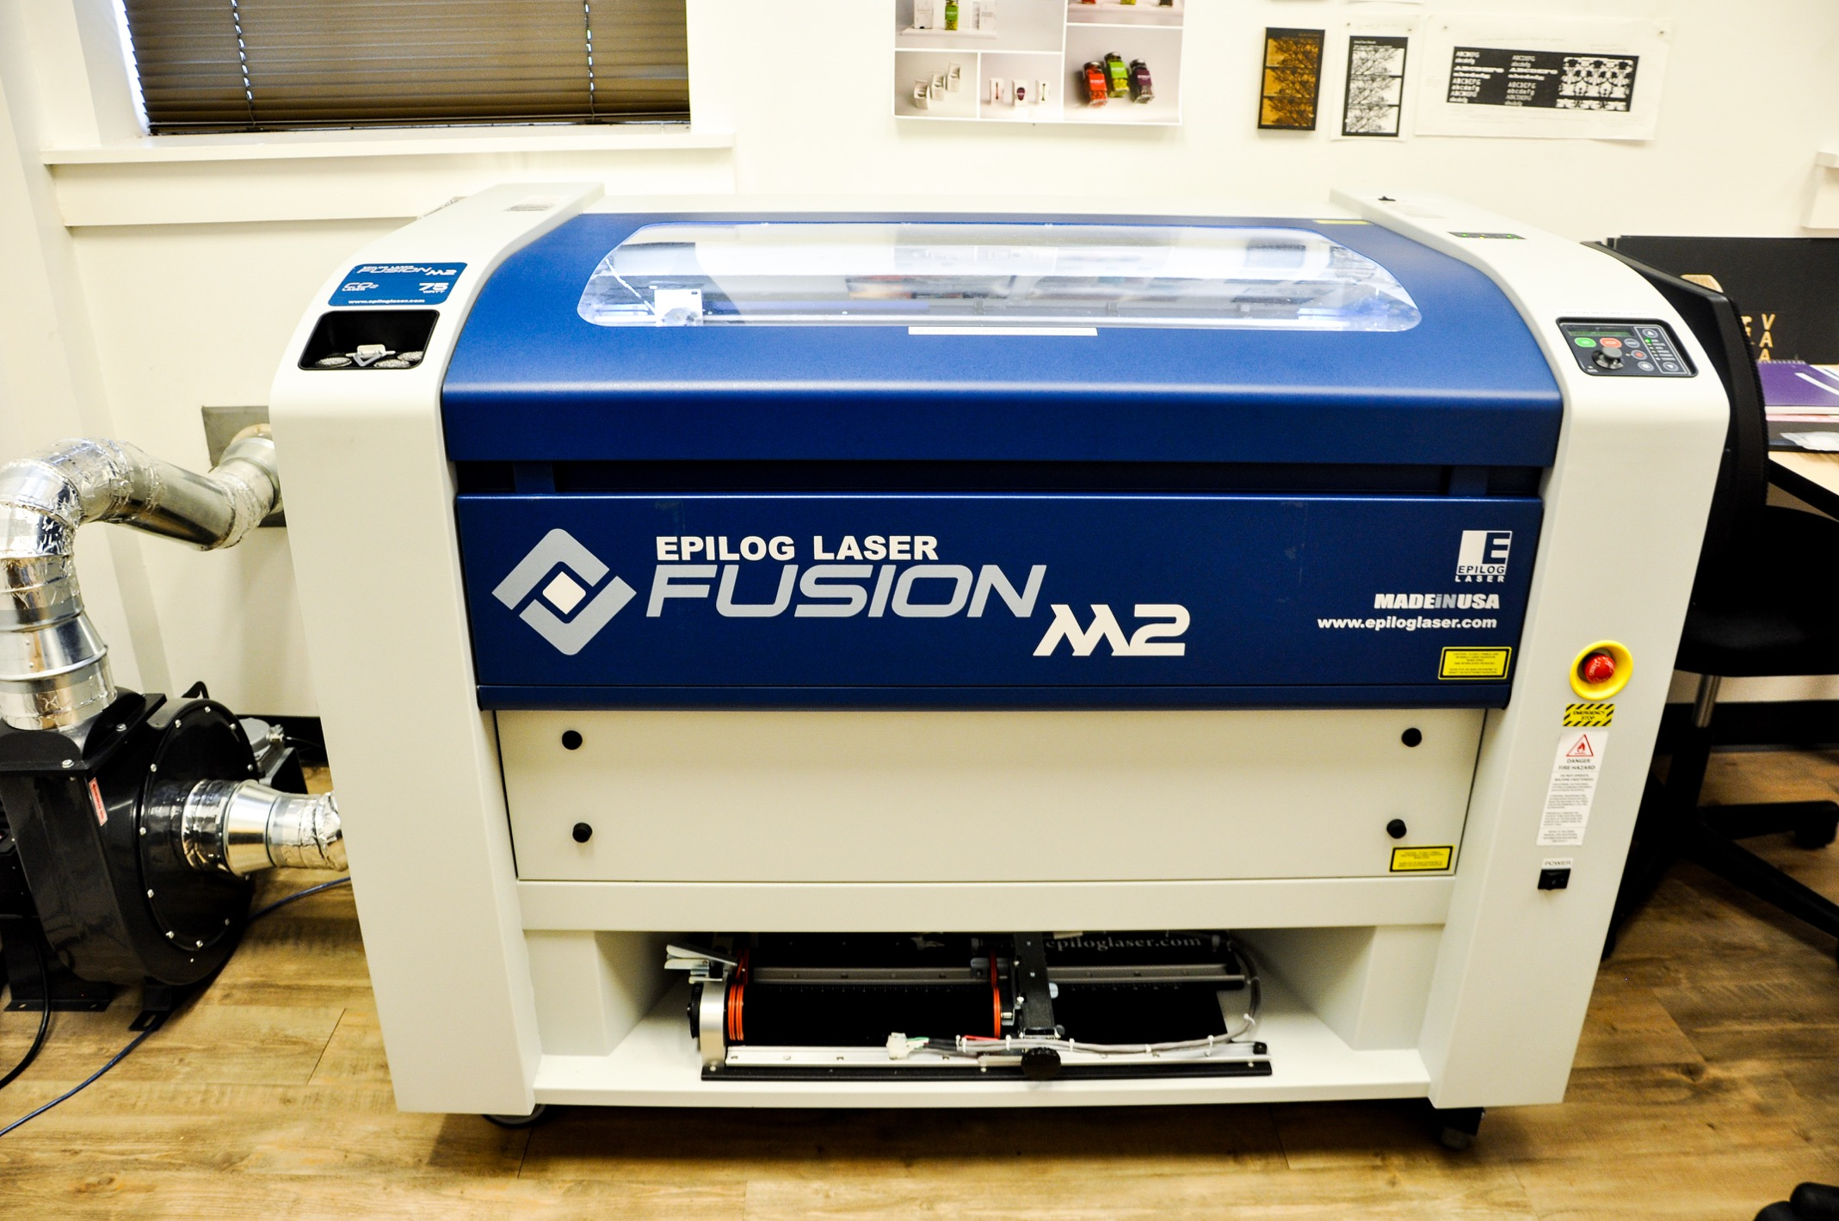
75 watt Laser cutter located in the VRC

Slide 4
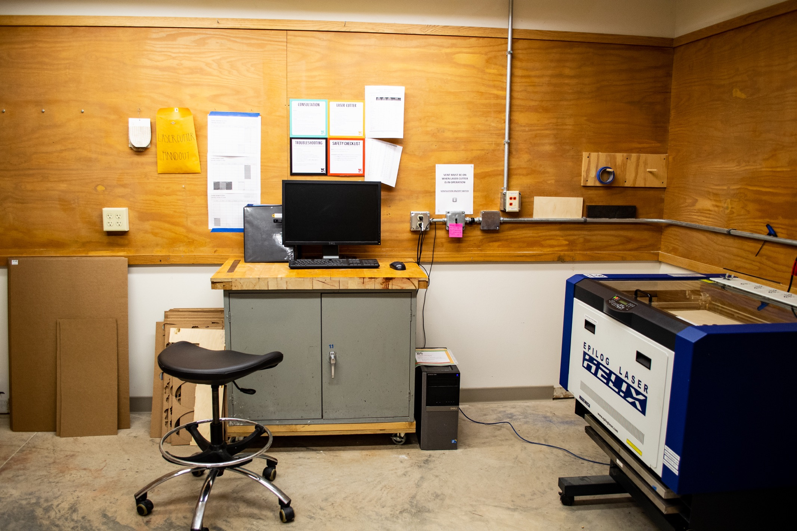
30 watt Laser cutter located in the vaa

Slide 5
Laser Information

Slide 6
Never open the lid while the laser is firing
The laser that “cuts” your materials is a high powered beam of energy that will burn the skin and damage the eye if exposed to the direct or reflected beams.
The wavelength of the high-powered cutting laser is outside of the visible spectrum, so you will not see a “dot” like you would with a laser pointer.
The laser fired by the machine is a class 4 laser (the highest class). The safety features on the equipment contain all laser radiation within the enclosure, so the machine is a class 2 system.
The alignment laser is a low powered red laser that allows you to see where your cut lines will be run.

Slide 7
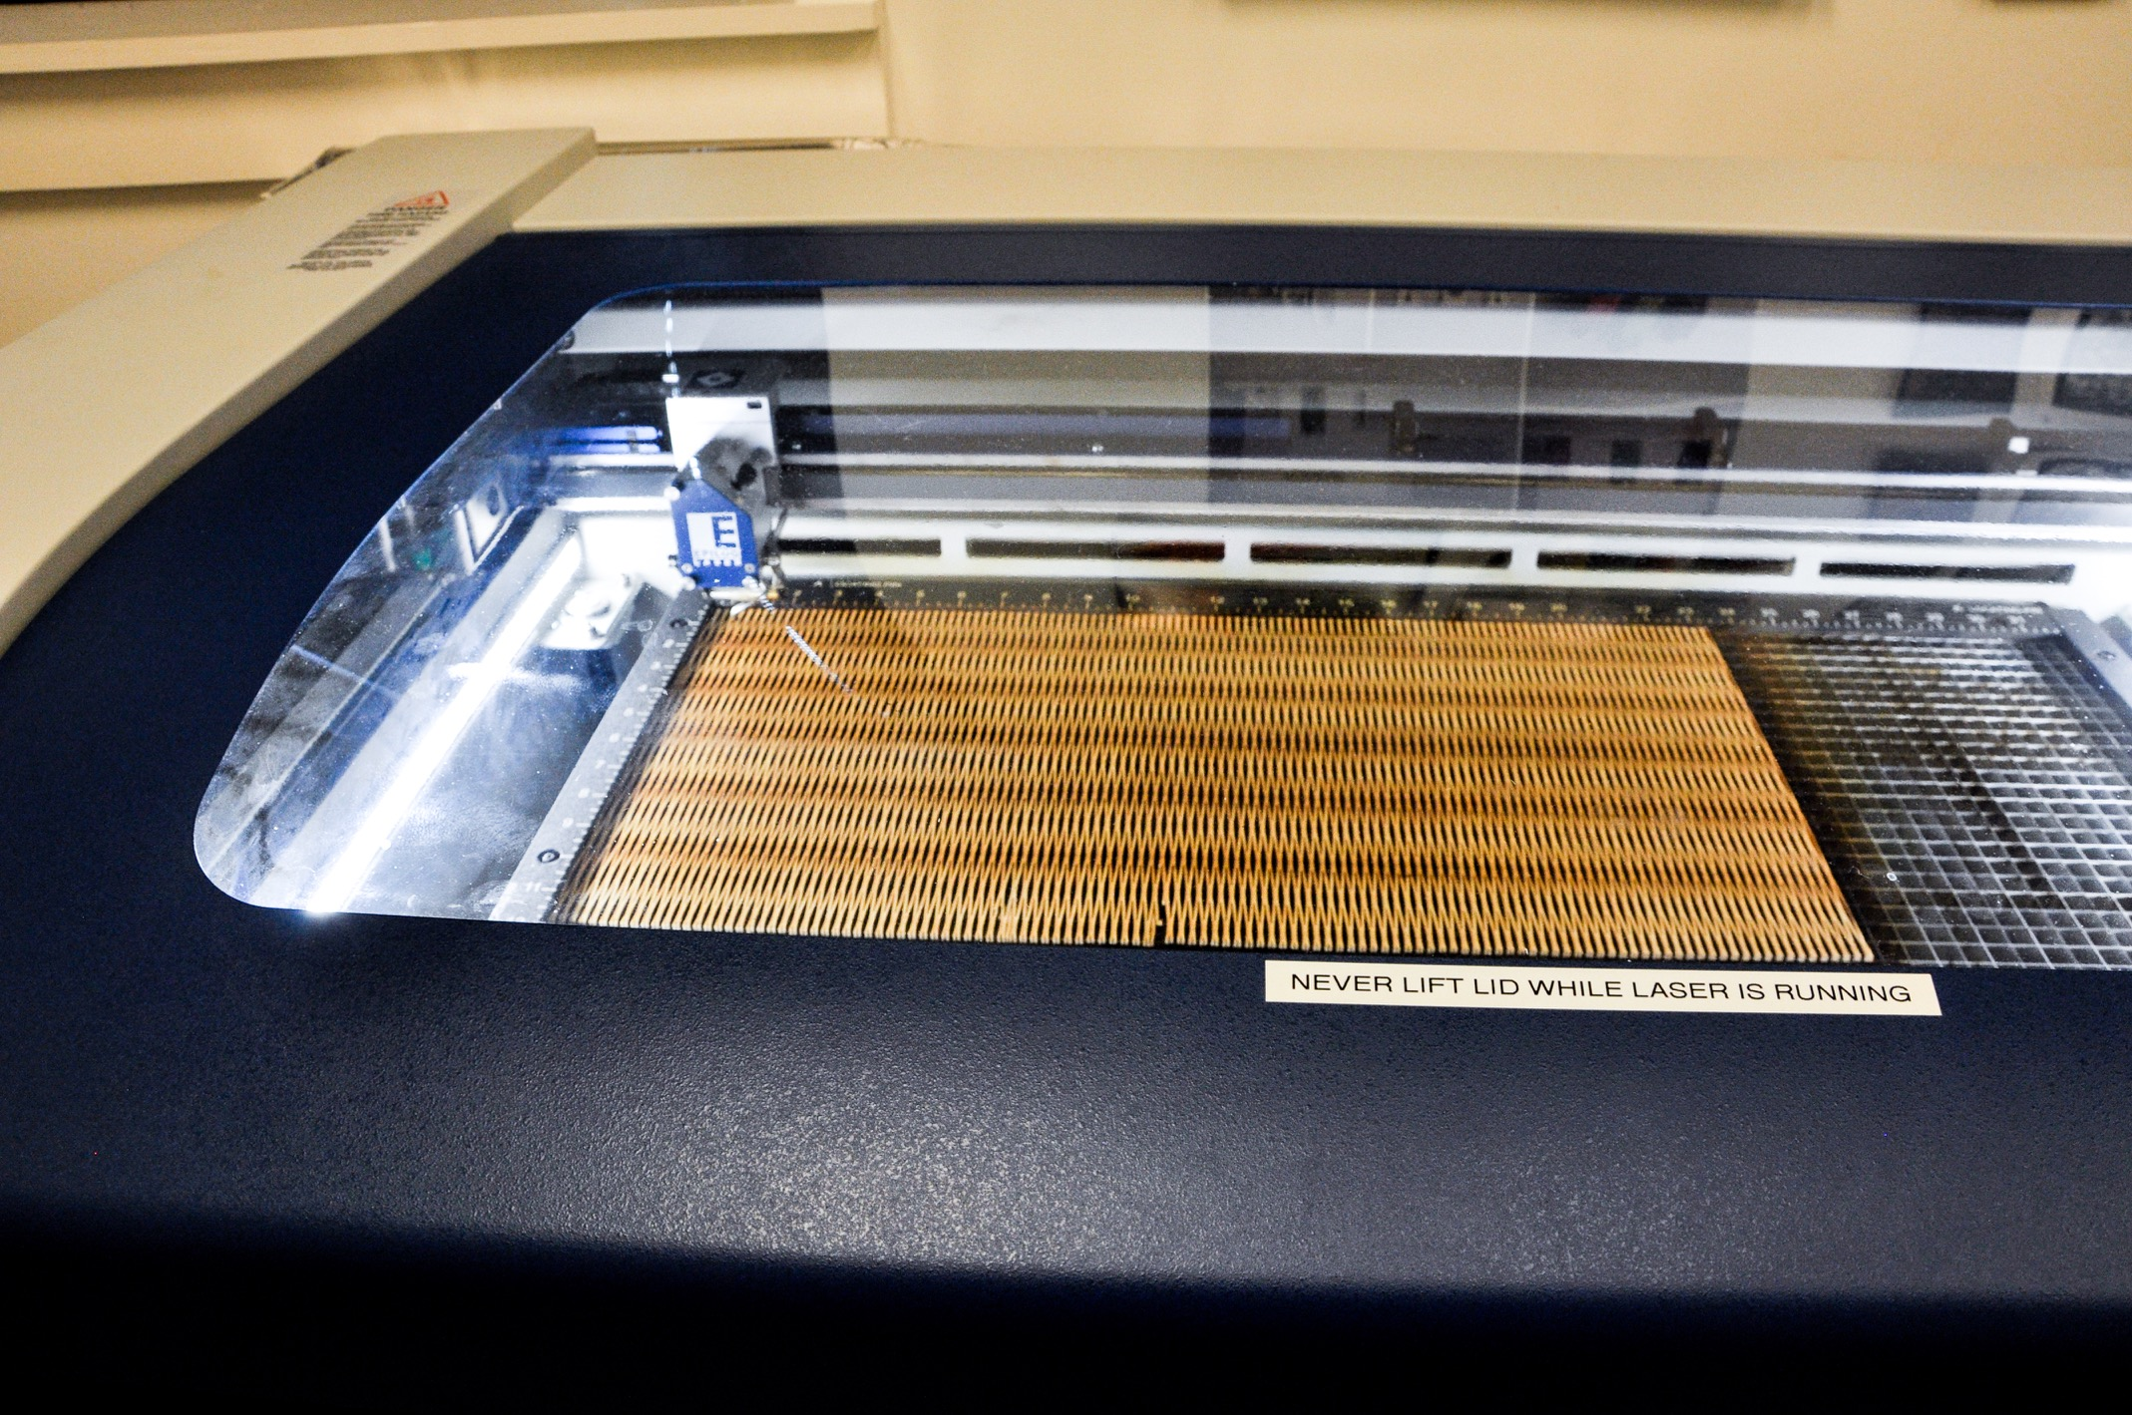
75 watt Laser
Protective polycarbonate lid. Never open lid while the laser is running.

Slide 8
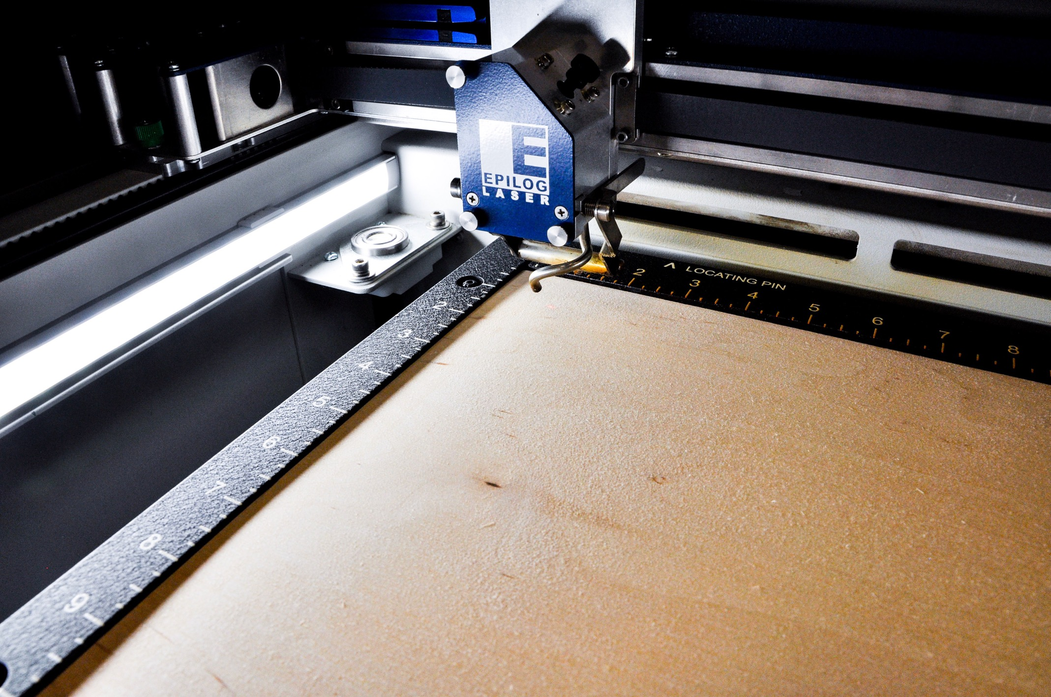
75 watt Laser
Alignment laser (red dot) and firing mechanism

Slide 9
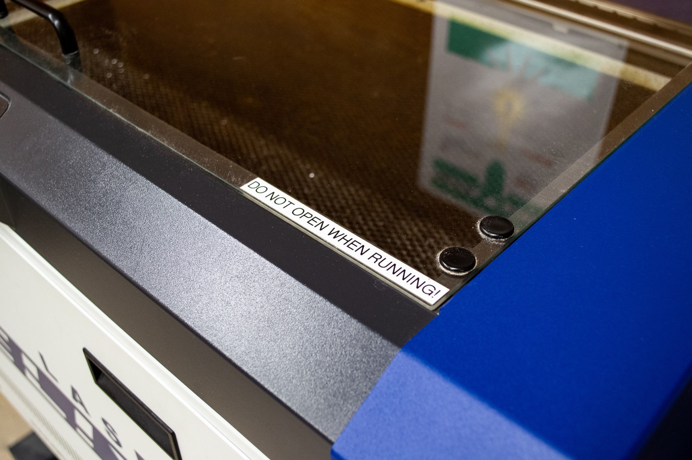
30 watt Laser
Protective polycarbonate lid. Never open lid while the laser is running.

Slide 10
Laser cutter safety features

Slide 11
Epilog 30 and 75 watt safety features
The Art Department has two laser cutters: at the Bartlett Center in the Visual Resource Center and at the Visual Arts Annex.
Both instruments have the following safety features:
The interlocking lid on each instrument has an electrical interlock that will interrupt the power to the laser when the lid is opened preventing any harm to the user from radiation. NEVER OPEN THE LID WHILE THE LASER IS FIRING.
The lid or viewing panel is made of a polycarbonate, it blocks the laser beam and the reflected radiation inside the instrument. If the lid is cracked, DO NOT use the instrument and report the problem to faculty or staff.
Both instruments have side panels that do not lock. DO NOT use the instrument if the panels are altered or removed and report the problem to faculty or staff. NEVER REMOVE OR TAMPER WITH THESE PANELS.

Slide 12
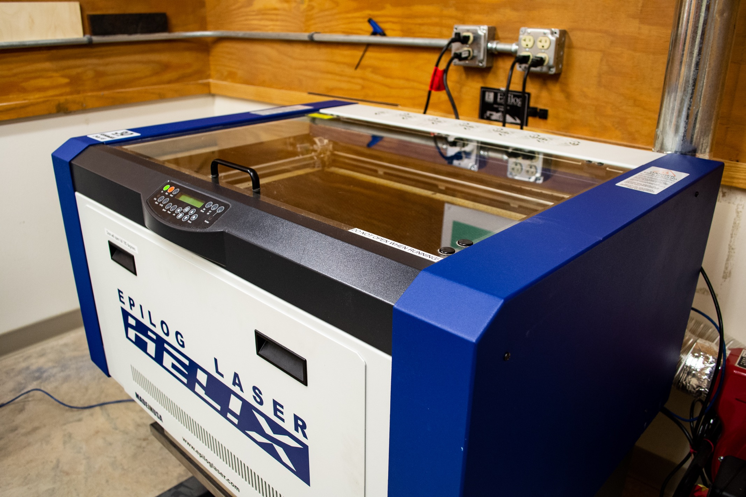
30 watt Laser
Non interlocking sides should NEVER be tampered with or removed.

Slide 13
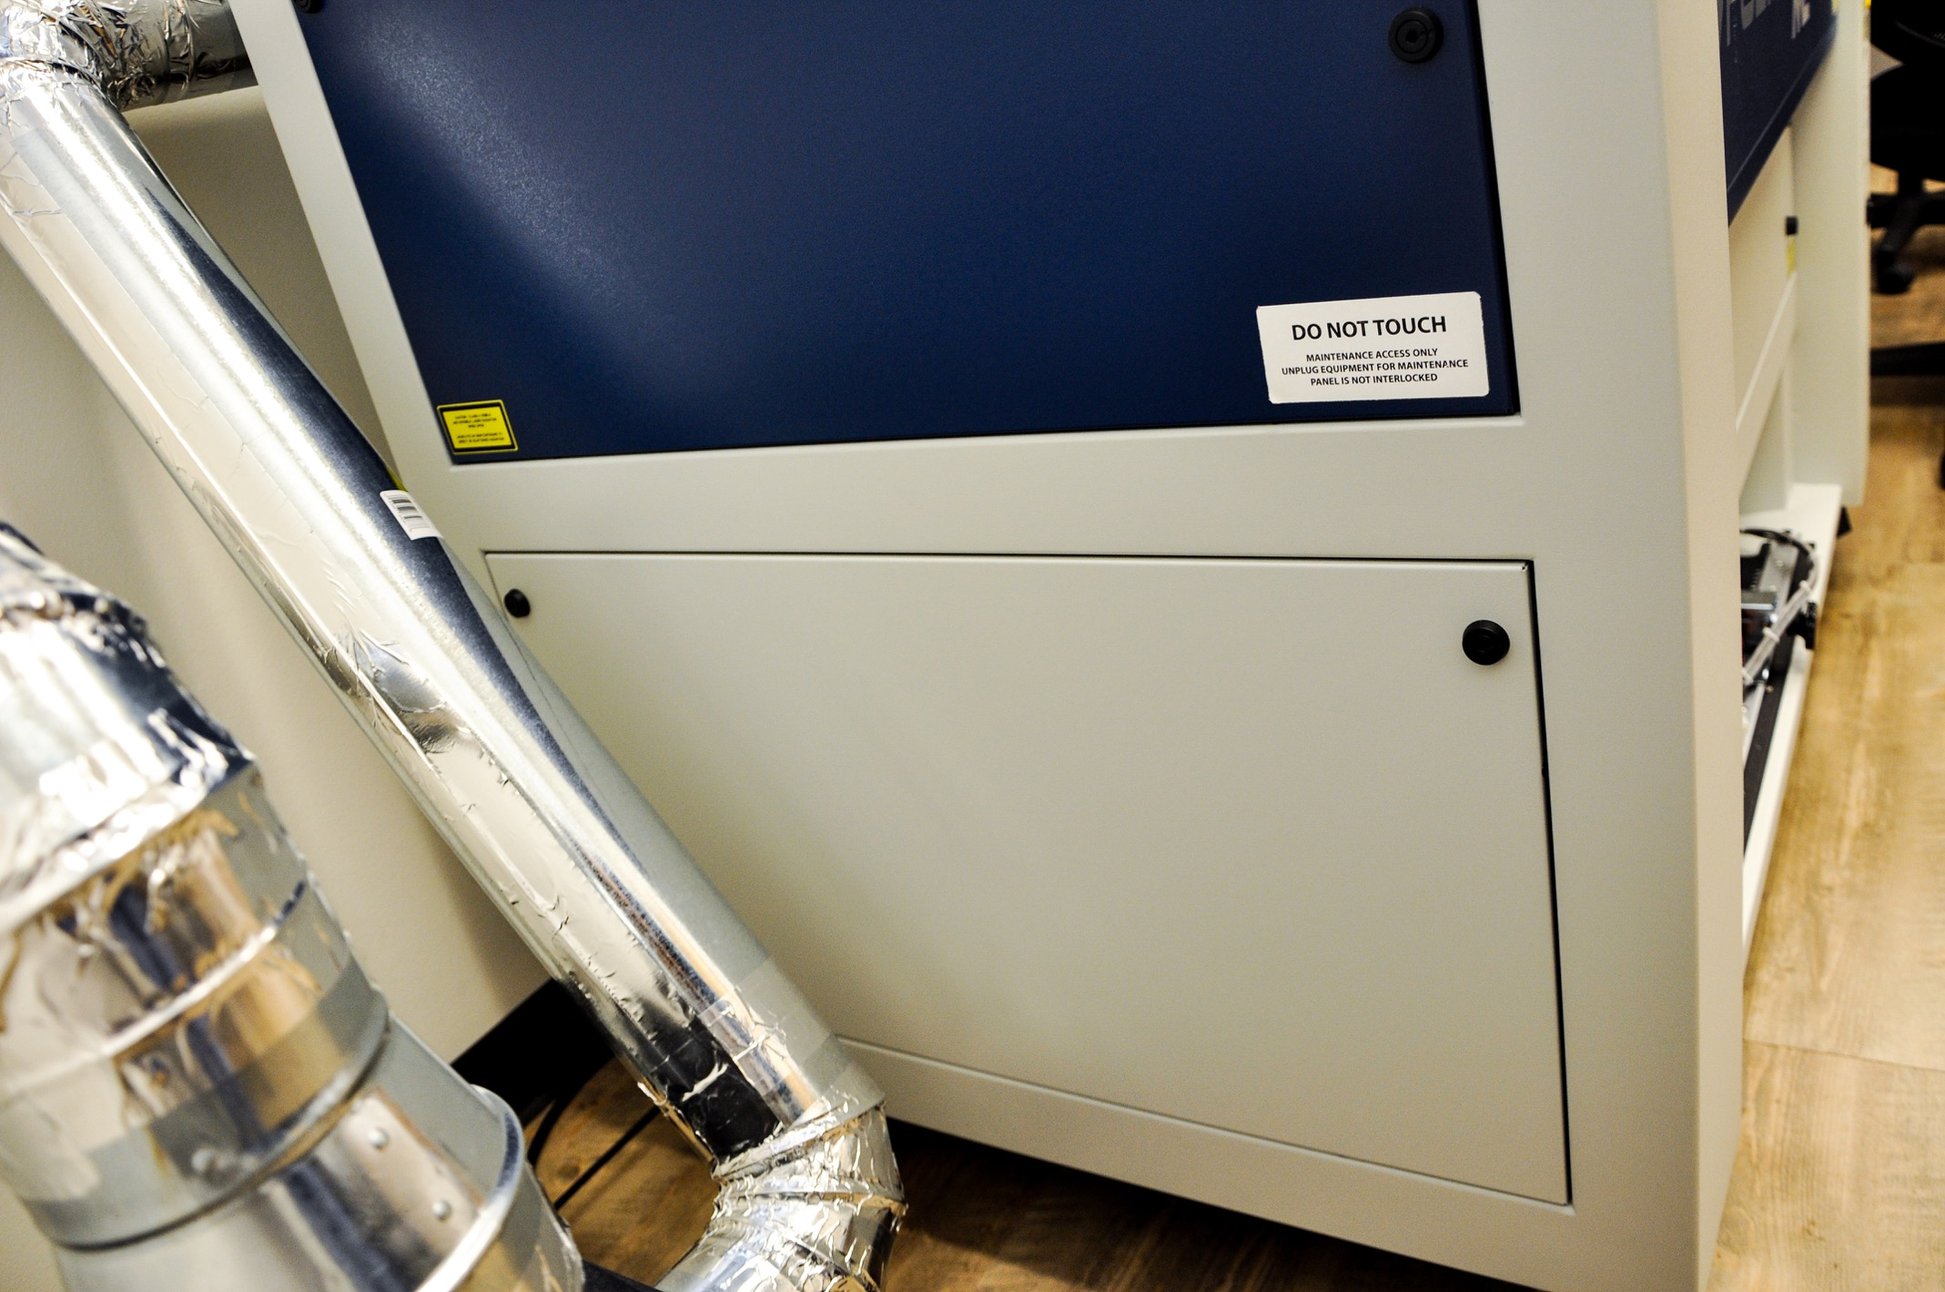
75 watt Laser
Non interlocking sides should NEVER be tampered with or removed

Slide 14
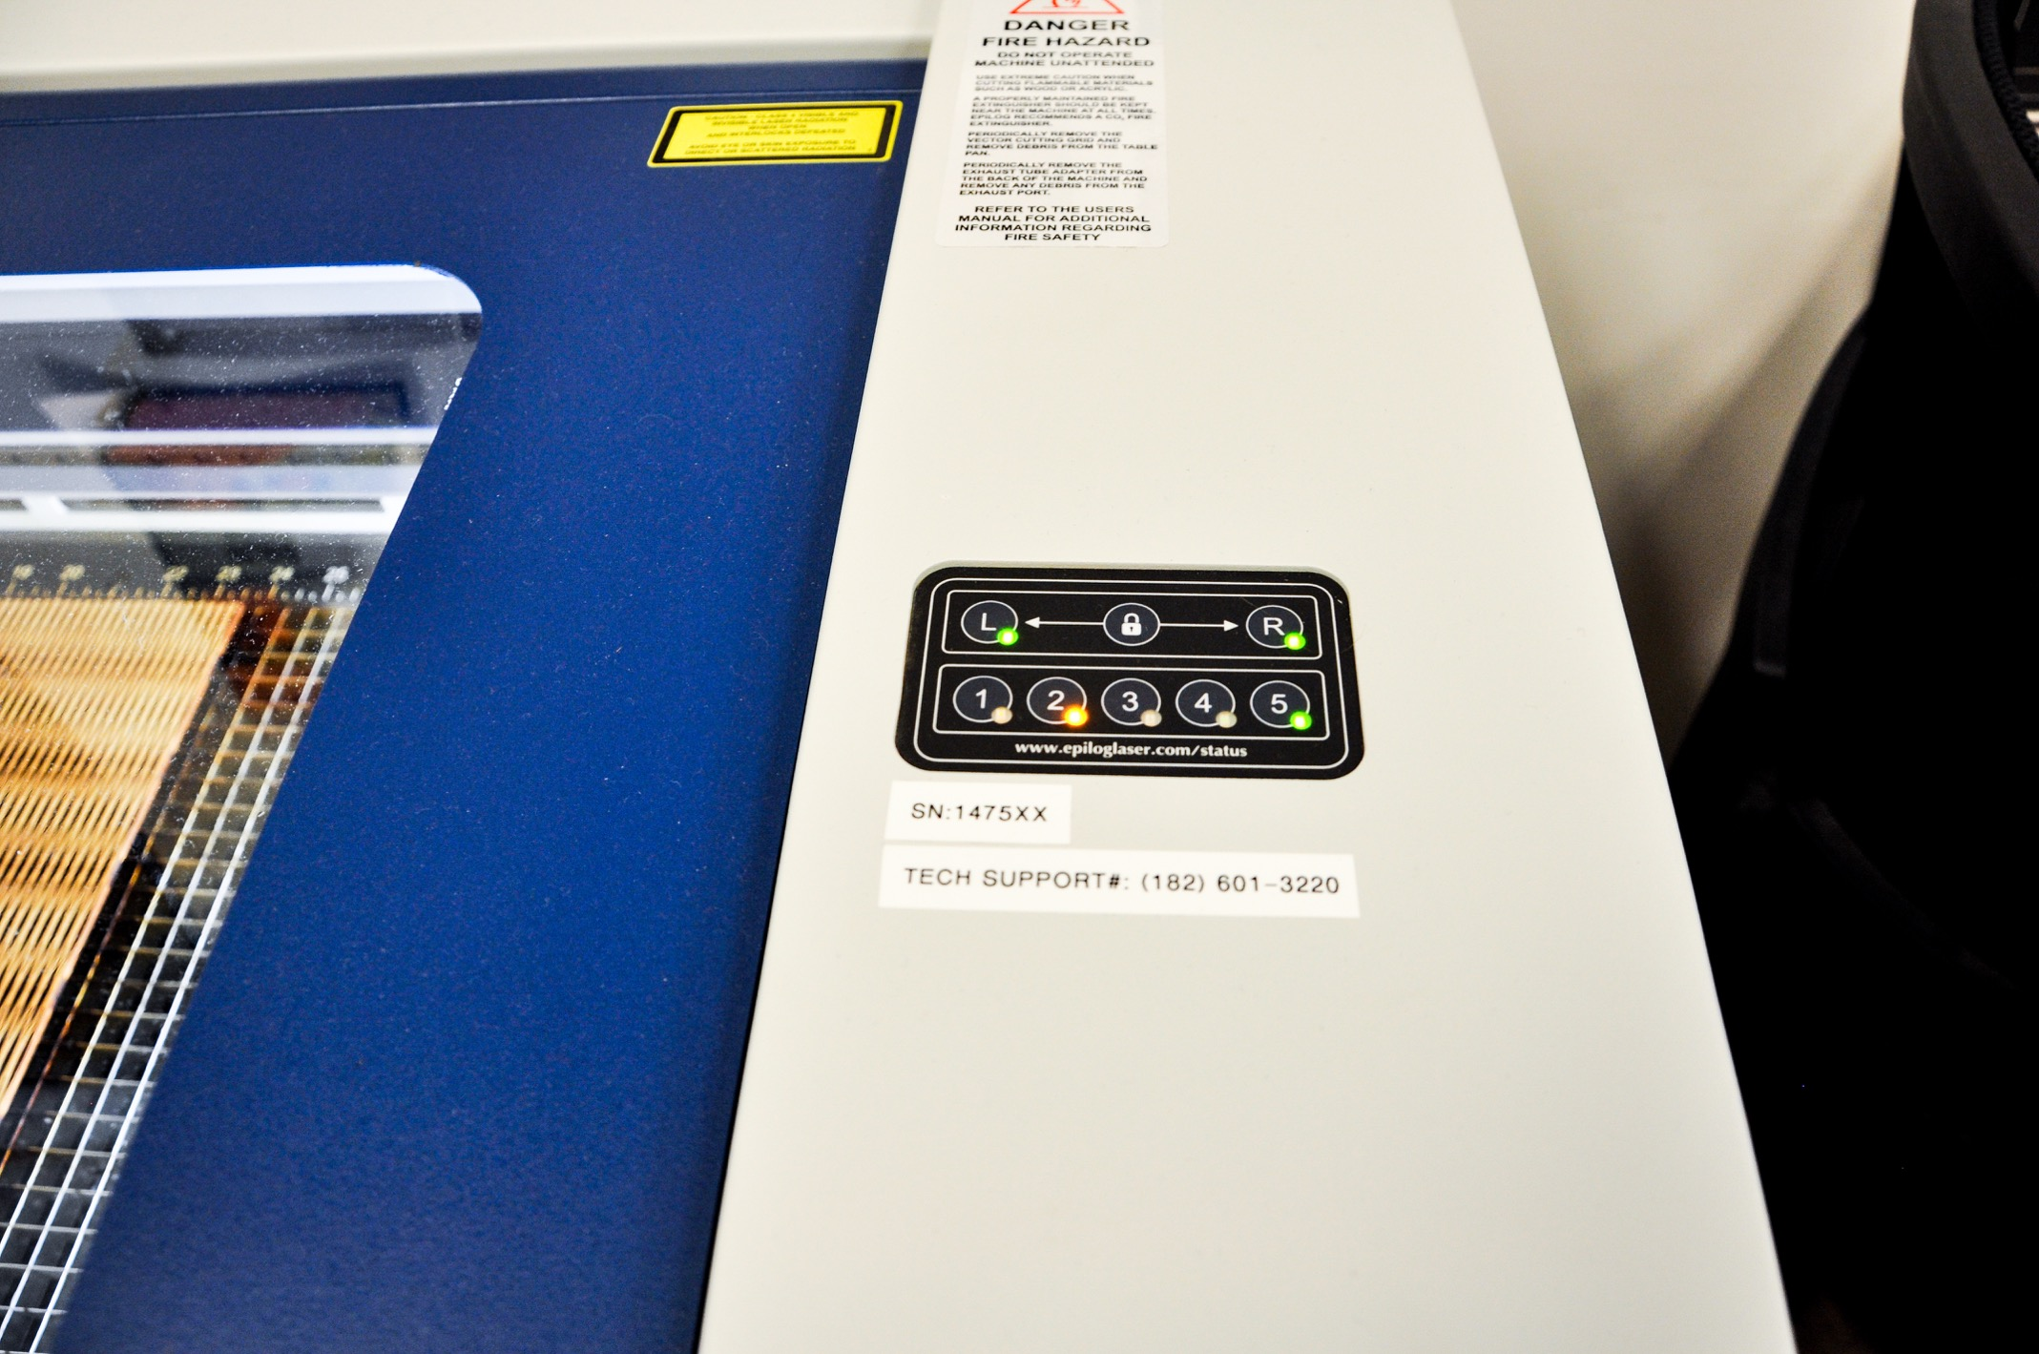
75 watt Laser
Green sensors indicate the lid is closed and the laser is safe to fire.

Slide 15
Laser Cutter Exhaust system

Slide 16
Exhaust system must always be turned on while laser is firing
Both laser cutters are equipped with an exhaust system to prevent excess heat and smoke from building up. Accidents happen when the system is not turned on and there is no air flow to prevent materials from catching fire.
What does the machine SOUND, SMELL, and LOOK like when it is operating properly?
Pay attention to the way the laser sounds when first operated with a staff member. If the machine is making unexpected noises, immediately press stop and seek assistance from faculty or staff.
If you smell excess smoke or abnormal burning, immediately press stop and seek assistance from faculty or staff.
If you see flares or smoke build up within the machine during cutting, immediately press stop and seek assistance from faculty or staff.

Slide 17
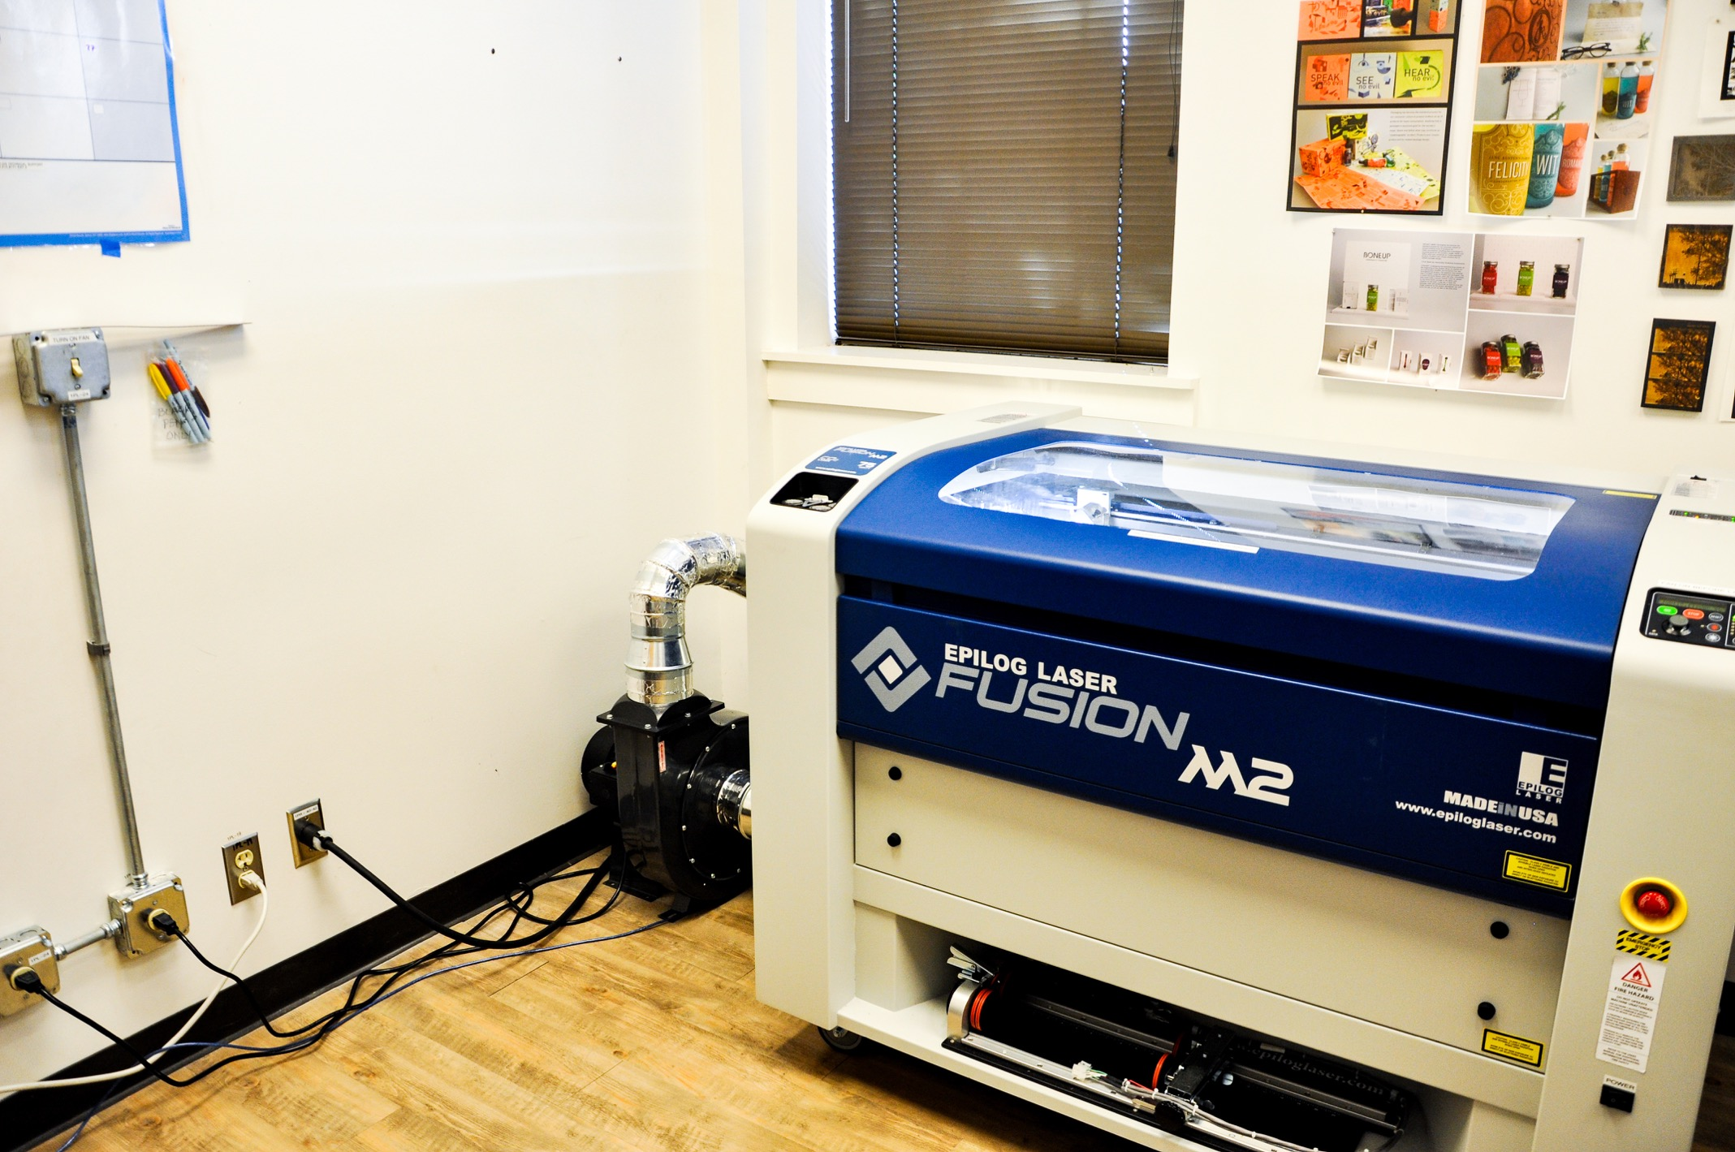
75 watt Laser
Exhaust system with vent and blower

Slide 18
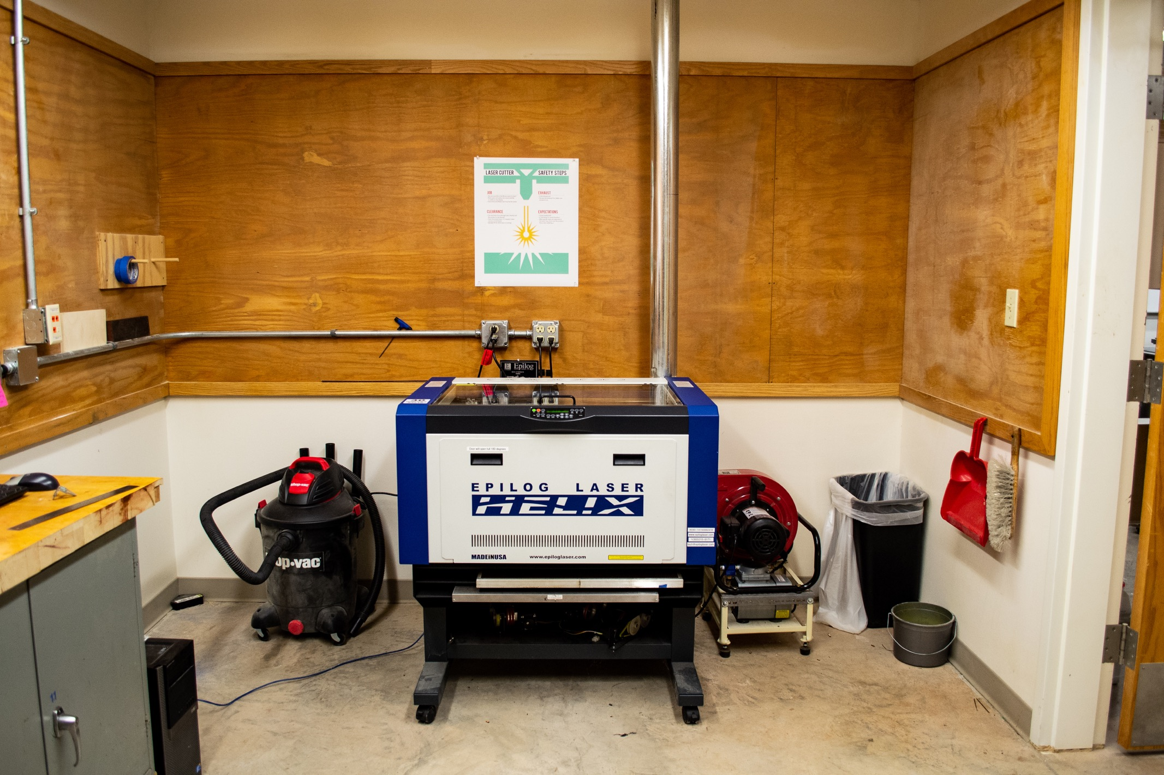
30 watt Laser
Exhaust system with vent and blower

Slide 19
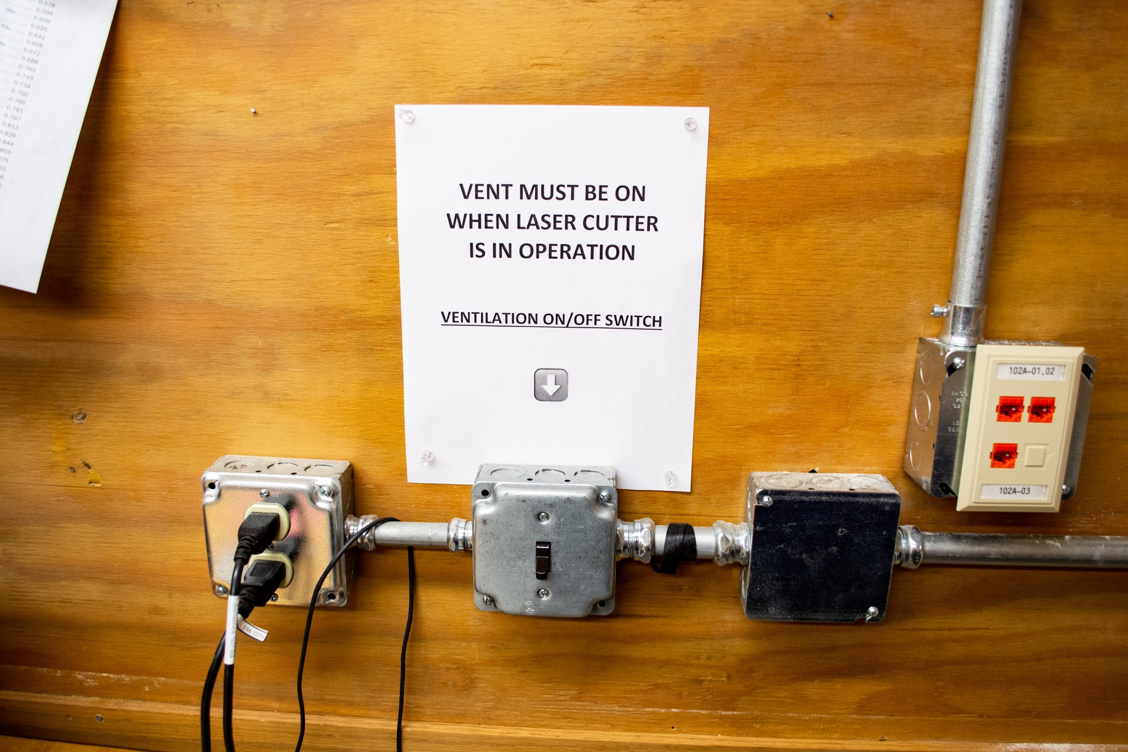
30 watt Laser

Slide 20
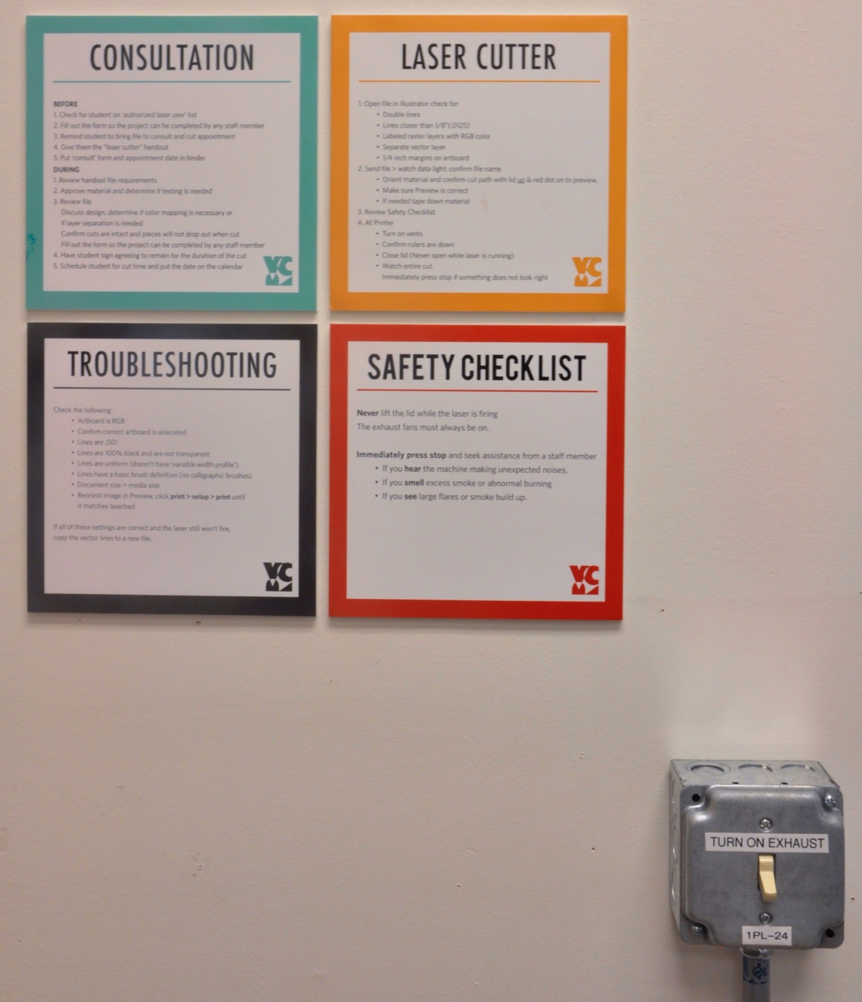
75 watt Laser

Slide 21
THE MOST COMMON SOURCE OF ACCIDENTS IS FIRE BUILDING UP INSIDE OF THE laser cutter DUE TO INADEQUATE EXHAUST. it is required that a trained, authorized operator be present at all times when the laser cutter is in operation Because of the inherent fire danger. NEVER LEAVE THE INSTRUMENT UNATTENDED WHILE OPERATING. If you need to step out of the room, pause the equipment and alert a Faculty or Staff member.

Slide 22
laserable materials

Slide 23
All materials MUST be PRE-approved
Some materials produce noxious fumes when they are cut. Our exhaust systems do not have filters, so we need to control which materials we cut to prevent release of noxious fumes.
There is an approved list of materials available in the VRC. If your material is not on the list, get it approved by Sally Schuh prior to cutting.
All plastics MUST be purchased through the VRC.

Slide 24
Now lets review

Slide 25
Review
The laser is a high powered invisible wavelength of energy that is fully contained in the machine by the enclosure and a polycarbonate lid.
Do not be afraid to use the laser cutter. The machine is safe when used properly and guidelines & instructions are followed.
Safety features must be in place to protect the user from harm.
Do not lift the lid while the laser is firing.
The exhaust system must always be on when the machine is in use.
All materials need to be pre-approved before use in the laser cutter.
Do not leave the equipment unattended.
Alert faculty or staff when it is not functioning properly, or if something seems off.
Ask a Faculty or Staff member when you have questions or concerns.

Slide 26
The quiz that follows will complete the training required by University Radiation Safety to use the laser cutter. VRC + VAA Staff will provide operational training for you to use the equipment.
Contact Sally:
Sally.schuh@okstate.edu

Slide 27
Department of Art, Graphic Design and Art History

